Slide 1
Divide and Conquer
Fang Xiaolin
School of Computer Science and Engineering
Southeast University

Slide 2
Outline
Divide and Conquer
Big Integer Multiplication
Matrix Multiplication
The k’th Smallest Element
Find the Nearest Point Pair
Fast Fourier Transform
Convex Hull Problem

Slide 3
Divide and Conquer
Design paradigm
Divide
Conquer
Combine

Slide 4
Divide and Conquer
Time Complexity
Recursive Equation
T(n)= aT(n/b)+D(n)+C(n)
Divide time：D(n)
Conquer time：aT(n/b)
Combine time：C(n)
When n<c, T(n)=θ(1)

Slide 5
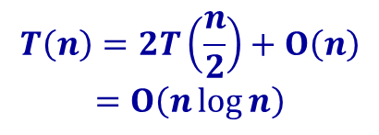
Divide and Conquer
Mergesort
21
25
49
25*
16
08
31
41
08
16
21
25
25*
31
41
49
21
25
49
25*
16
08
31
41
21
25
25*
49
08
16
31
41
21
25
49
25*
16
08
31
41
21
25
25*
49
08
16
31
41
21
25
49
25*
16
08
31
41
21
25
49
25*
16
08
31
41
$$T\left(n\right)=2T\left(\frac{n}{2}\right)+Ο\left(n\right)$$
$$=Ο\left(n\log{n}\right)$$

Slide 6

Divide and Conquer
Find the maximum element
49
21
25
49
25*
16
08
31
41
49
41
21
25
49
25*
16
08
31
41
25
49
16
41
21
25
49
25*
16
08
31
41
$$T\left(n\right)=2T\left(\frac{n}{2}\right)+1$$
$$=n−1$$

Slide 7
Binary Search
Search 40
0
1
2
3
4
5
Given an ordered array
low=0, high=n-1,mid=(low+high)/2
Compare x and mid’th element
x==mid, success
x<mid, search left subarray
high=mid-1, mid=(low+high)/2
x>mid，search right subarray
low=mid+1, mid=(low+high)/2
10
20
30
40
50
60
low
mid
high
40>30
0
1
2
3
4
5
10
20
30
40
50
60
low
mid
high
40<50
0
1
2
3
4
5
10
20
30
40
50
60
low
mid
high
Success
40=40

Slide 8
Binary Search
search 25
0
1
2
3
4
5
Given an ordered array
Compare x and mid’th element
x==mid, success
x<mid, search left subarray
high=mid-1, mid=(low+high)/2
x>mid，search right subarray
low=mid+1, mid=(low+high)/2
10
20
30
40
50
60
low
mid
high
25<30
0
1
2
3
4
5
10
20
30
40
50
60
low
mid
high
25>10
0
1
2
3
4
5
0
1
2
3
4
5
10
20
30
40
50
60
10
20
30
40
50
60
mid
high
low
low
mid
high
25>20
low>high，Failed

Slide 9
Binary Search
<
30
>
=
10
50
Given an ordered array
Full binary tree
n=2^{h}-1
2^{h}=n+1，h=log₂(n+1)
Average search length
<
=
>
<
=
>
20
40
60
<
=
>
<
=
>
<
=
>
Dislocation subtraction

Slide 10

Big Integer Multiplication
Given n-bit binary integer X and Y
Naïve algorithm $Ο(n^{2})$
Divide and conquer, reduce to $Ο(n^{1.59})$

Slide 11




Big Integer Multiplication
n/2 bit
n/2 bit
n/2 bit
n/2 bit
X=
A B
Y=
C D
XY = (A2^{n/2} + B)(C2^{n/2} + D)
= AC2^{n} + (AD+BC)2^{n/2} + BD
2^{n} means shift left n bits
$$T\left(n\right)=4T\left(\frac{n}{2}\right)+Θ\left(n\right)$$
$$∵a=4, b=2, f\left(n\right)=Θ\left(n\right), n^{\log_{2}{4}}=n^{2}$$
${f\left(n\right)=n}^{\log_{2}{4}−ε}, ε=1$,
$$∴T\left(n\right)={Θ(n}^{\log_{2}{4}})={Θ(n}^{2})$$
Not reduce the time
Notes:
1101101101101101*1101101101101101
1234567890*1234567890

Slide 12



Big Integer Multiplication
n/2 bit
n/2 bit
n/2 bit
n/2 bit
X=
A B
Y=
C D
XY = (A2^{n/2} + B)(C2^{n/2} + D)
= AC2^{n} + ((A+B)(C+D)-AC-BD)2^{n/2} + BD
2^{n} means shift left n bits
$$T\left(n\right)=3T\left(\frac{n}{2}\right)+Θ\left(n\right)$$
$$∵a=3, b=2, f\left(n\right)=Θ\left(n\right), n^{\log_{2}{3}}≈n^{1.59}$$
${f\left(n\right)=n}^{\log_{2}{3}−ε}, ε≈0.59$,
$$∴T\left(n\right)={Θ(n}^{\log_{2}{3}})={Θ(n}^{1.59})$$
Reduce the time

Slide 13

Matrix Multiplication
Two matrix $A$ and $B$, each $n×n$
Naïve algorithm time $Ο(n^{3})$
Divide and conquer reduce to $Ο(n^{2.81})$

Slide 14




Matrix Multiplication
Two matrix $A$ and $B$, each $n×n$
Divide $A$ and $B$ into 4 $\frac{n}{2}×\frac{n}{2}$ submatrixes
=
C₁₁=A₁₁B₁₁+A₁₂B₂₁，C₁₂= A₁₁B₁₂+ A₁₂B₂₂
C₂₁=A₂₁B₁₁+A₂₂B₂₁，C₂₂= A₂₁B₁₂+ A₂₂B₂₂
$$T\left(n\right)=8T\left(\frac{n}{2}\right)+Θ\left(n^{2}\right)$$
$$∵a=8, b=2, f\left(n\right)=Θ\left(n^{2}\right), n^{\log_{2}{8}}=n^{3}$$
${f\left(n\right)=n}^{\log_{2}{8}−ε}, ε=1$,
$$∴T\left(n\right)={Θ(n}^{\log_{2}{8}})={Θ(n}^{3})$$
Not reduce the time

Slide 15
Matrix Multiplication
Two matrix $A$ and $B$, each $n×n$
Divide $A$ and $B$ into 4 $\frac{n}{2}×\frac{n}{2}$ submatrixes
=
Reduce 8 submatrix multiplication to 7
M₁ = A₁₁ (B₁₂ - B₂₂)
M₂ = (A₁₁ + A₁₂) B₂₂
M₃ = (A₂₁ + A₂₂) B₁₁
M₄ = A₂₂ (B₂₁ - B₁₁)
M₅ = (A₁₁ + A₂₂) (B₁₁ + B₂₂)
M₆ = (A₁₂ - A₂₂) (B₂₁ + B₂₂)
M₇= (A₁₁ – A₂₁) (B₁₁ + B₁₂)
C₁₁ = M₅ + M₄ - M₂ + M₆
C₁₂ = M₁ + M₂
C₂₁ = M₃ + M₄
C₂₂ = M₅ + M₁ – M₃ – M₇

Slide 16



Matrix Multiplication
Two matrix $A$ and $B$, each $n×n$
Divide $A$ and $B$ into 4 $\frac{n}{2}×\frac{n}{2}$ submatrixes
=
Reduce 8 submatrix multiplication to 7
$$T\left(n\right)=7T\left(\frac{n}{2}\right)+Θ\left(n^{2}\right)$$
C₁₁ = M₅ + M₄ - M₂ + M₆
C₁₂ = M₁ + M₂
C₂₁ = M₃ + M₄
C₂₂ = M₅ + M₁ – M₃ – M₇
$$∵a=7, b=2, f\left(n\right)=Θ\left(n^{2}\right), n^{\log_{2}{7}}≈n^{2.81}$$
${f\left(n\right)=n}^{\log_{2}{7}−ε}, ε≈0.81$,
$$∴T\left(n\right)={Θ(n}^{\log_{2}{7}})={Θ(n}^{2.81})$$
Reduce the time

Slide 17

Matrix Multiplication
Two matrix $A$ and $B$, each $n×n$
Better algorithm can reduce time to ${Θ(n}^{2.376})$
Time can be reduced more？
It is unknown !

Slide 18
Quick Sort
Main idea
Partition：pick a pivot x，element less than x move left，greater than x move right
Recursively quick sort for two sub arrays
initial
21
25
49
25*
16
08
Layer 1
08
16
21
25*
25
49
Pivot 21
Layer 2
08
16
21
25*
25
49
Left pivot 8，right pivot 25*
Layer 3
08
16
21
25*
25
49
Left pivot 16，right pivot 25
Layer 4
08
16
21
25*
25
49
Right pivot 49

Slide 19
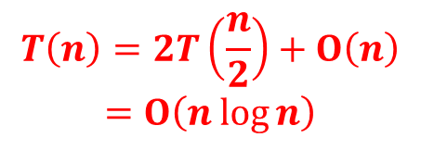
Quick Sort
$$T\left(n\right)=2T\left(\frac{n}{2}\right)+Ο\left(n\right)$$
$$=Ο\left(n\log{n}\right)$$
Partition(low,high)
Initially pivot p = low, x=a[low]=21
From i=low+1，element less than x swap with the element next to p，and p = p+1
Loop until i > high，swap a[low] and a[p]
21
25
49
25*
16
08
21
16
49
25*
25
08
i
i
p
p
Swap a[i] and a[p+1], p++
Swap a[i] and a[p+1], p++
21
16
08
25*
25
49
08
16
21
25*
25
49
i>high, stop
p
p
Swap a[low] and a[p]

Slide 20

Find k’th smallest element
Given array of length $n$ , find $k$’th smallest
Heap sort $Ο(\operatorname{klog}{n})$
Worst case $k$ near to $\frac{n}{2}$ , heap sort $Ο(\operatorname{nlog}{n})$

Slide 21
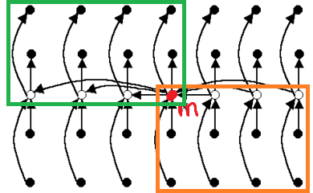
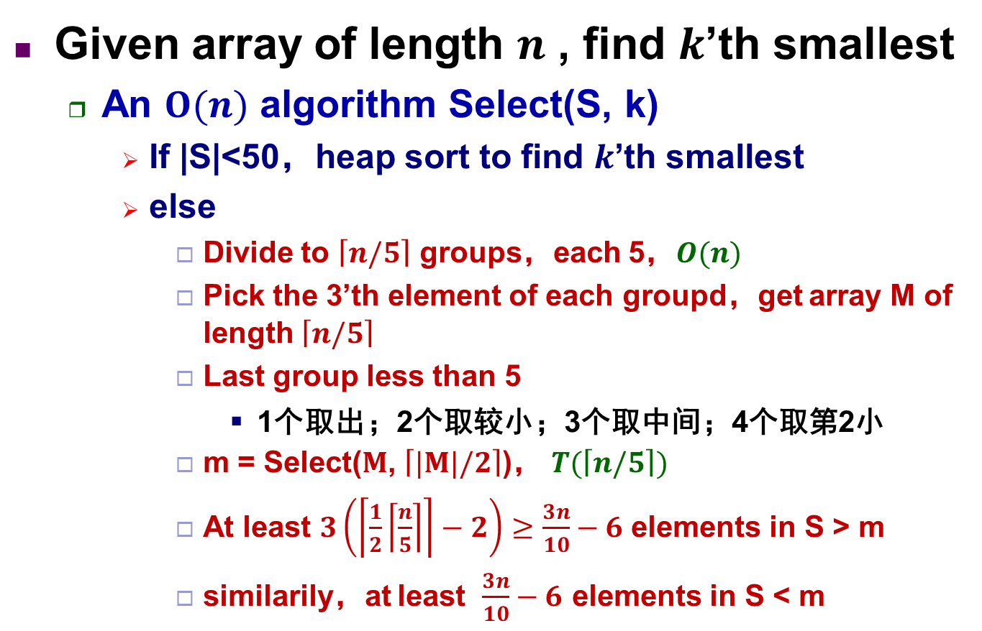
Find k’th smallest element
Given array of length $n$ , find $k$’th smallest
An $Ο(n)$ algorithm Select(S, k)
If |S|<50，heap sort to find $k$’th smallest
else
Divide to $\left\lceil n/5\right\rceil$ groups，each 5，$Ο(n)$
Pick the 3’th element of each groupd，get array M of length $\left\lceil n/5\right\rceil$
Last group less than 5
1个取出；2个取较小；3个取中间；4个取第2小
m = Select($M$, $\left\lceil |M|/2\right\rceil$)， $T(\left\lceil n/5\right\rceil )$
At least $3\left(\left\lceil \frac{1}{2}\left\lceil \frac{n}{5}\right\rceil \right\rceil −2\right)≥\frac{3n}{10}−6$ elements in S > m
similarily，at least $\frac{3n}{10}−6$ elements in S < m
Notes:
-2表示排除最后组和中间那一组，故得3n/10-6

Slide 22
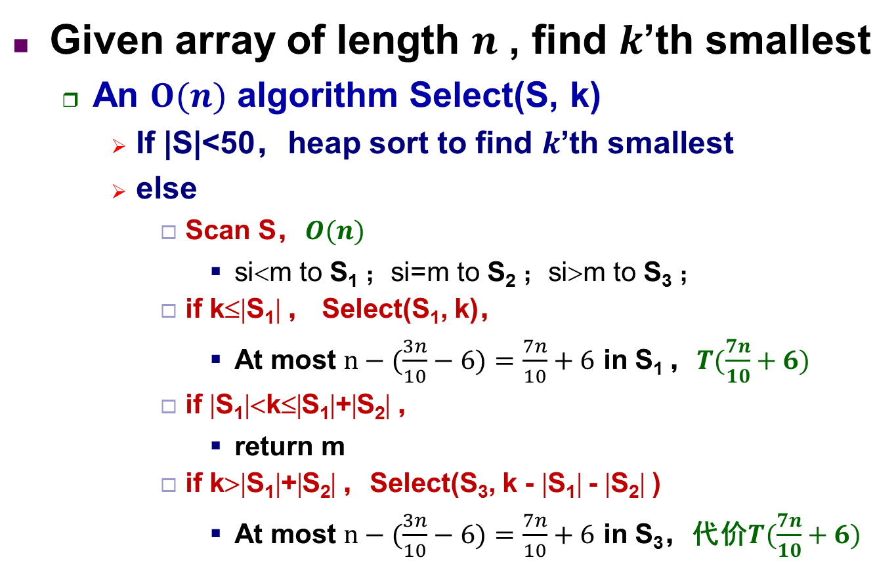
Find k’th smallest element
Given array of length $n$ , find $k$’th smallest
An $Ο(n)$ algorithm Select(S, k)
If |S|<50，heap sort to find $k$’th smallest
else
Scan S，$Ο(n)$
si<m to S₁ ；si=m to S₂ ；si>m to S₃ ；
if k≤|S₁| ， Select(S₁, k)，
At most $n−(\frac{3n}{10}−6)=\frac{7n}{10}+6$ in S₁ ，$T(\frac{7n}{10}+6)$
if |S₁|<k≤|S₁|+|S₂| ，
return m
if k>|S₁|+|S₂| ，Select(S₃, k - |S₁| - |S₂| )
At most $n−(\frac{3n}{10}−6)=\frac{7n}{10}+6$ in S₃，代价$T(\frac{7n}{10}+6)$

Slide 23
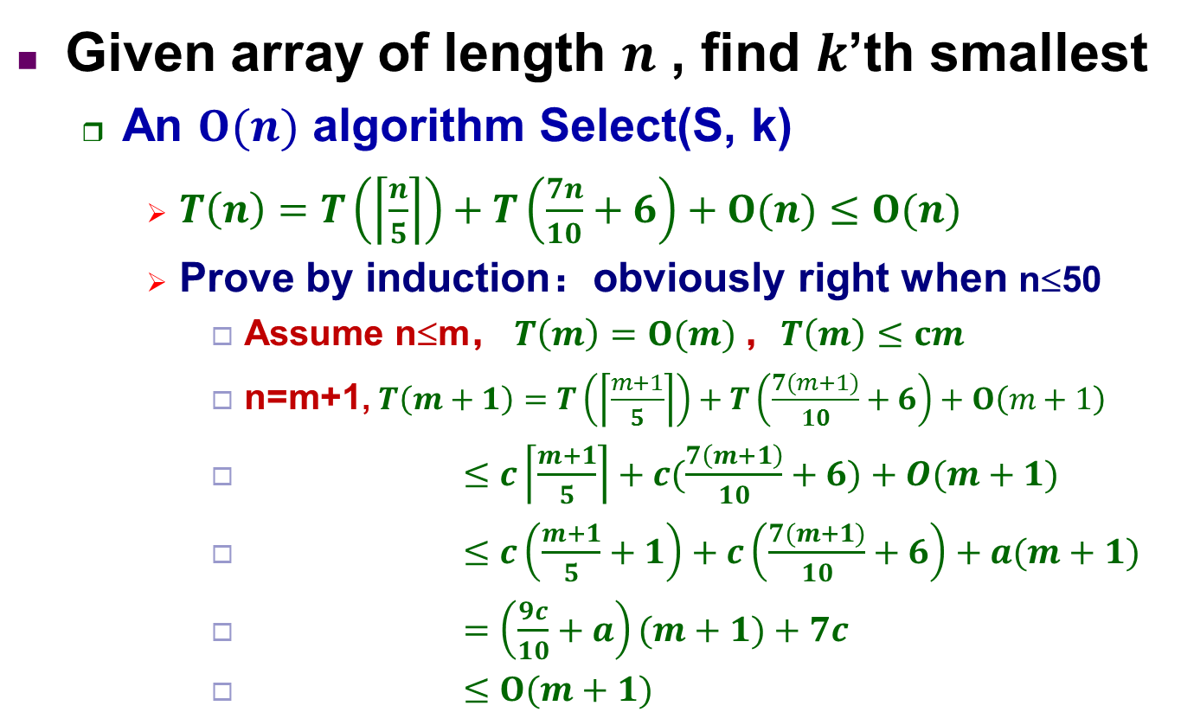
Find k’th smallest element
Given array of length $n$ , find $k$’th smallest
An $Ο(n)$ algorithm Select(S, k)
$T\left(n\right)=T\left(\left\lceil \frac{n}{5}\right\rceil \right)+T\left(\frac{7n}{10}+6\right)+Ο(n)≤Ο(n)$
Prove by induction：obviously right when n≤50
Assume n≤m， $T\left(m\right)=O(m)$，$T\left(m\right)≤cm$
n=m+1, $T\left(m+1\right)=T\left(\left\lceil \frac{m+1}{5}\right\rceil \right)+T\left(\frac{7(m+1)}{10}+6\right)+Ο\left(m+1\right)$
$≤c\left\lceil \frac{m+1}{5}\right\rceil +c(\frac{7\left(m+1\right)}{10}+6)+Ο(m+1)$
$≤c\left(\frac{m+1}{5}+1\right)+c\left(\frac{7(m+1)}{10}+6\right)+a(m+1)$
$=\left(\frac{9c}{10}+a\right)(m+1)+7c$
$≤O(m+1)$

Slide 24
Heap sort
Main idea
Build max-heap
Loop until output all elements
Swap root and the last element in the max-heap
Remove it from the max-heap
i=0
21
i=2
i=1
21
21
49
25
49
25
49
25
49
25
21
25*
16
08
25*
16
08
25*
16
08
25*
16
08
21
25
49
25*
16
08
21
25
49
25*
16
08
21
25
49
25*
16
08
49
25
21
25*
16
08
最后一元素的父节点
i=2开始调整
调整i=1
调整i=0
形成最大堆

Slide 25
Heap sort
Main idea
Build max-heap
Loop until output all elements
Swap root and the last element in the max-heap
Remove it from the max-heap
49
25
25*
25
21
25*
21
16
21
25*
16
08
08
16
49
08
25
49
49
25
21
25*
16
08
25
25*
21
08
16
49
25*
16
21
08
25
49
Swap 49 and 08
Swap 25 and 16
Swap 25* and 08
Update it to max-heap
Update it to max-heap
Update it to max-heap

Slide 26
Heap sort
Main idea
Build max-heap
Loop until output all elements
Swap root and the last element in the max-heap
Remove it from the max-heap
21
16
08
16
08
08
21
16
21
25*
25
49
25*
25
49
25*
25
49
21
16
08
25*
25
49
16
08
21
25*
25
49
08
16
21
25*
25
49
Swap 21 and 08
Swap 16 and 08
Update it to max-heap
Update it to max-heap
Update it to max-heap

Slide 27
Heap sort
Time complexity
Built max-heap
n elements in the heap, complete binary tree has k layers (2^{k-1}≤n＜2^{k})
i‘th layer to the leaf distance: k-i,
i‘th layer node number 2^{i-1}
Total moving times
Loop output element
n-1 times，each update distance⎡log₂(n+1)⎤
Total time: O(nlog₂n)
Notes:
建立最大堆复杂度求解：2S-S

Slide 28
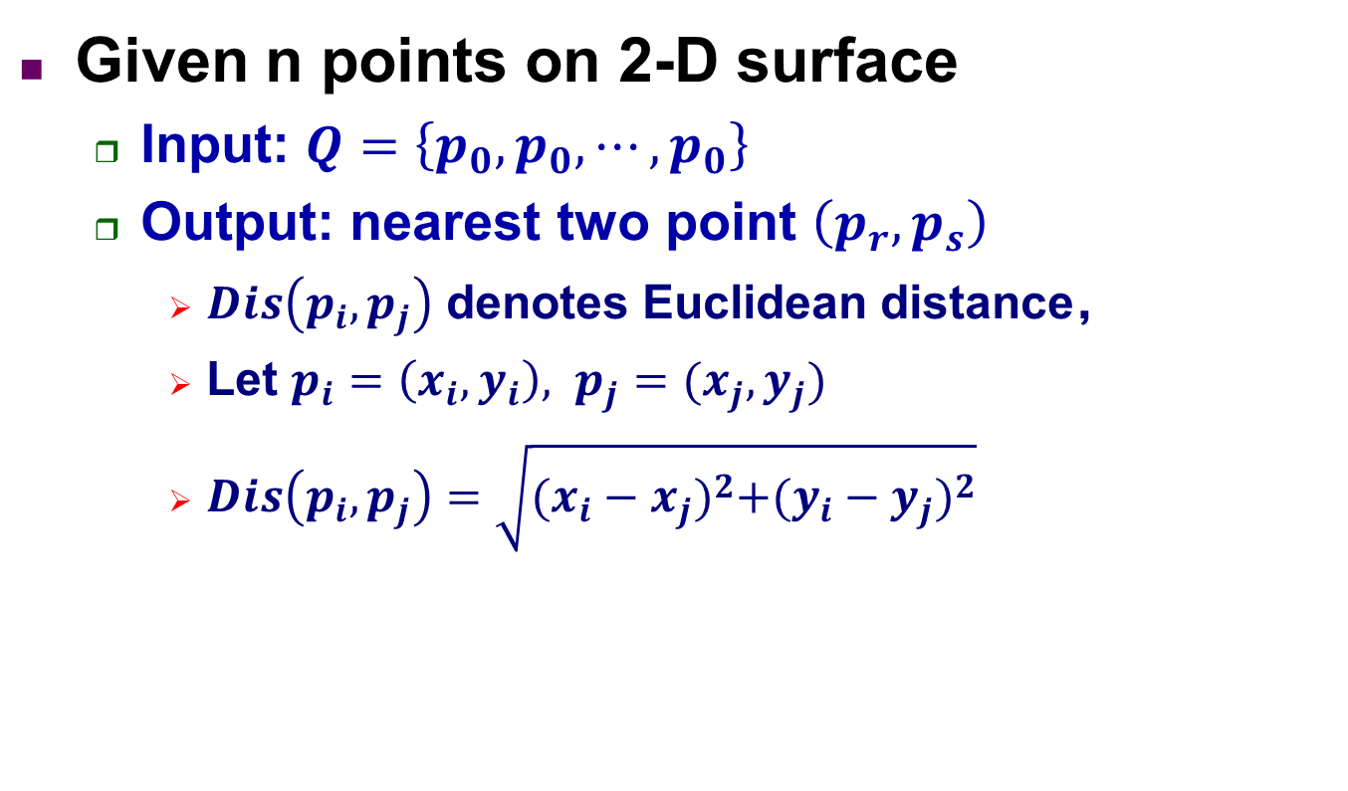
Find the Nearest Point Pair
Given n points on 2-D surface
Input: $Q=\left\{p_{0},p_{0},⋯,p_{0}\right\}$
Output: nearest two point $\left(p_{r},p_{s}\right)$
$Dis\left(p_{i},p_{j}\right)$ denotes Euclidean distance，
Let $p_{i}=\left(x_{i},y_{i}\right), p_{j}=(x_{j},y_{j})$
$Dis\left(p_{i},p_{j}\right)=\sqrt{{(x_{i}−x_{j})}^{2}+{(y_{i}−y_{j})}^{2}}$

Slide 29
Find the Nearest Point Pair
Given n points on 2-D surface
Preprocessing
如果Q中仅包含一个点，则算法结束
把Q中的点按 x-坐标值和 y-坐标值排序
Divide:
计算Q中各点x-坐标的中位数m
用垂线 x=m 把P划分成两个大小相等的子集合L和R， L中点在 x=m左边，R 中点在x=m 右边

Slide 30
Find the Nearest Point Pair
Given n points on 2-D surface
critical
L
R
p₁
p₂
q₁
q₂
m-d
x=m
m+d
Recursive find result in L、R：(p1, p2)∈L , (q1, q2)∈R
d=min{Dis(p1, p2), Dis(q1, q2)};
Find dis(pl, qr) less than d in critical area, pl∈L, qr∈R;
If finds， (pl, qr) is the result，
Else (p1, p2) or (q1, q2) is the result
如何查找 (pl, qr)

Slide 31
Find the Nearest Point Pair
Given n points on 2-D surface
Find dis(pl, qr) < d in critical area, pl∈L, qr∈R
d
d
d
d
d
d
D
p
D
2d
p
median
median
极端情况下，p在中位线上，q在绿色半圆D中。
不妨把D扩大为d*2d的矩形区域，这样的区域内最多可能存在多少个点，使每两点距离≥d？
答案是6个（鸽巢原理），即对于任一点p，最多只需计算6次距离可以了
对于左临界区中任一点 p，
在右临界区中找一点q，
若Dis(p,q)<d，则必然有
q落于绿色区域D内

Slide 32
Find the Nearest Point Pair
Given n points on 2-D surface
Find dis(pl, qr) < d in critical area, pl∈L, qr∈R
d
d
p
median

Slide 33
Find the Nearest Point Pair
O(nlogn)
对Q按x轴从小到大排序
对Q中点按y轴从小到大排序放放Y中，并记录各点对应Q中的下标
CPair(i, j, Q, Y) //返回数组Q中i到j的最近距离d，以及最近两点p,q
n = j-i+1
if m < 3 then return 最近距离d,及其点对(p,q);
YL = Q中 i 到 i+ ⎡n/2⎤-1点按y轴从小到大排好的序;//不需重新排序了
YR = Q中 i+⎡n/2⎤ 到 j 点按y轴从小到大排好的序;//不需重新排序了
(d1, pr, ps) = CPair(i, i+ ⎡n/2⎤-1, Q, YL);
(d2, pr’, ps’) = CPair(i+⎡n/2⎤, j, Q, YR);
(d, pr, ps)记录d1和d2更小值
x_{中位线}=(Q_{x}[i+⎡m/2⎤-1]+ Q_{x}[i+⎡m/2⎤])/2
Yd = 落于[x_{中位线}-d, x_{中位线}+d]带中按y轴从小到大排好的序;//不需重新排序
对于Yd任一点，与前6个、后6个比较找最小的(d’,p,q)
if d’< d return (d’,p,q)
else return (d, pr, ps)
O(nlogn)
T(n/2)
T(n/2)

Slide 34
Find the Nearest Point Pair
Time complexity
T(n) = O(1) n = 2
T(n) = 2T(n/2) + O(n) n ≥ 3
用Master定理求解
T(n) = O(nlogn)

Slide 35
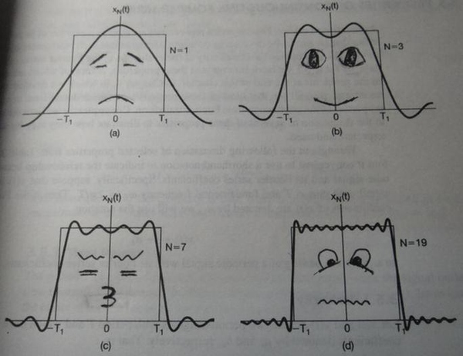
Fast Fourier Transform
Fourier Transform overview
Any wave can be approximated by the sum of some sine waves
Fig.1： 1 sine wave
Fig.2： 2 sine waves
Fig.3： 4 sine waves
Fig.4： 10 sine waves

Slide 36
Fast Fourier Transform
Fourier Transform overview
Any wave can be approximated by the sum of some sine waves
1个正弦波
2个正弦波的叠加
3个正弦波的叠加
4个正弦波的叠加

Slide 37
Fast Fourier Transform
Fourier Transform overview
Any wave can be approximated by the sum of some sine waves

Slide 38
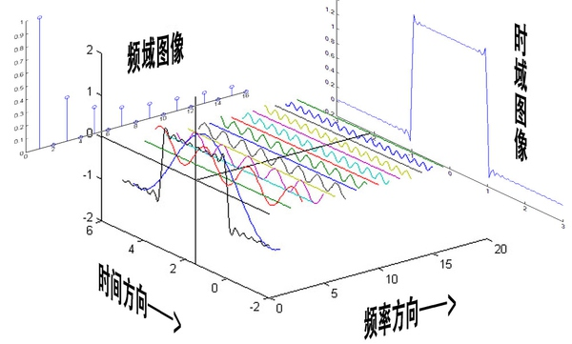
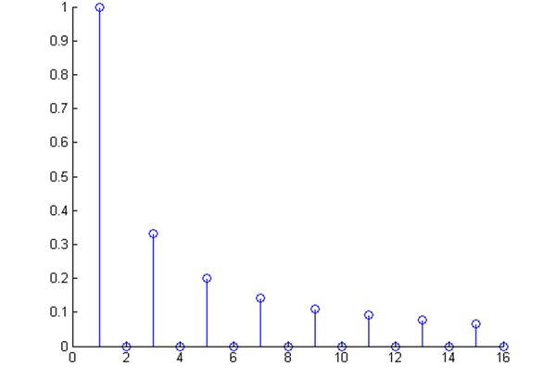
Fast Fourier Transform
Fourier Transform overview
Any wave can be approximated by the sum of some sine waves
Notes:
be perpendicular to

Slide 39
Fast Fourier Transform
Fourier Transform overview
Any wave can be approximated by the sum of some sine waves
Input: signals sequence with length n (usually 2^{k})
Output: the amplitudes (AM) and phases (PH) on some frequencies
Notes:
http://www.eefocus.com/rf-microwave/337133
假设采样频率为Fs，信号频率F，采样点数为N，n点所表示的频率为：Fn=(n-1)*Fs/N
如Fs=1，采1024个值，可分辨到1/1024Hz频率

Slide 40
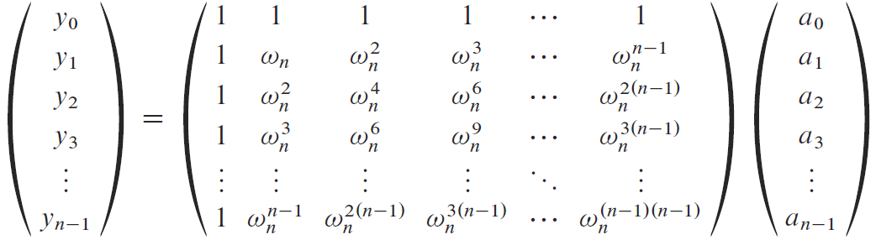

Fast Fourier Transform
Discrete Fourier transform (DFT)
Let $ω_{n}=e^{2πi/n}$，称为n阶复根
$ω_{n}^{n}={(e^{2πi/n})}^{n}=e^{2πi}=\cos{2π}+i\sin{2π}=1$
$y_{k}=\sum_{j=0}^{n−1}{a_{j}^{}ω_{n}^{kj}}$
$=a_{0}+a_{1}ω_{n}^{k}+a_{2}ω_{n}^{2k}+⋯+a_{n−1}ω_{n}^{(n−1)k}$
Notes:
yk表示第k个频率上的振幅与相位，因为yk是一个复数

Slide 41
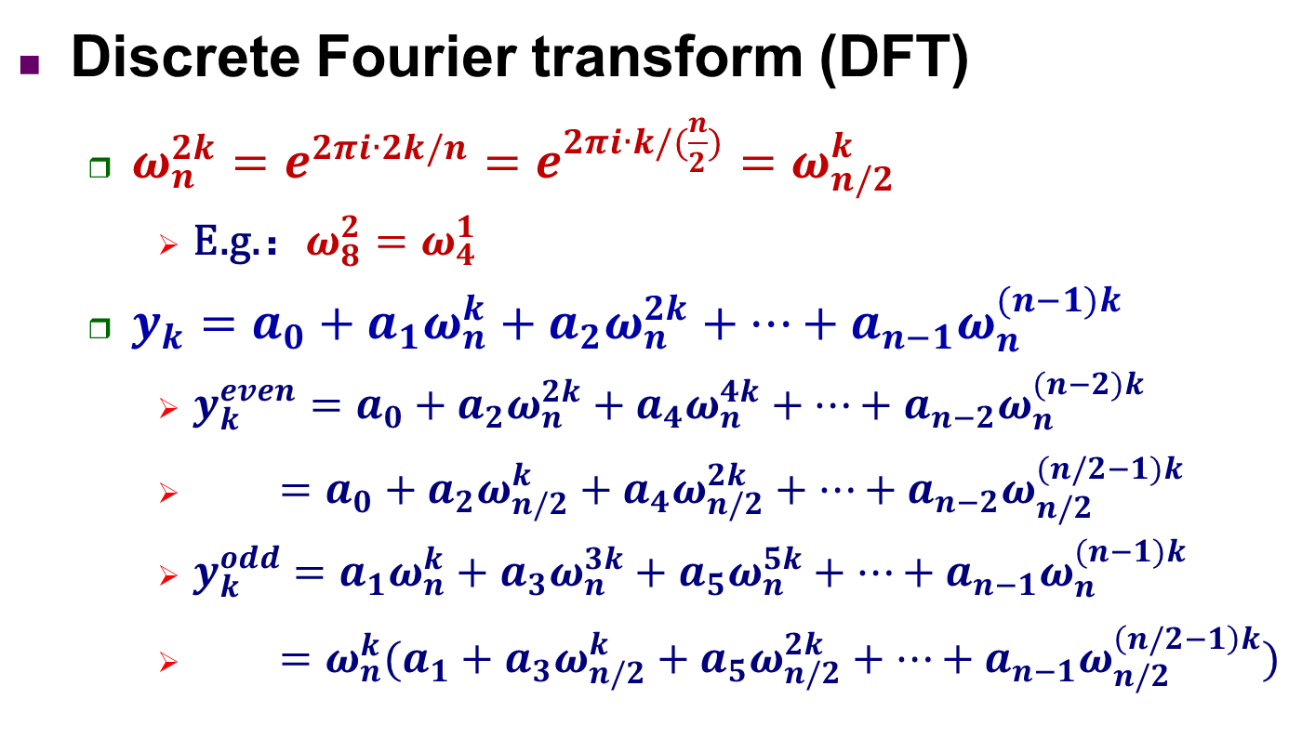
Fast Fourier Transform
Discrete Fourier transform (DFT)
$ω_{n}^{2k}=e^{2πi∙2k/n}=e^{2πi∙k/(\frac{n}{2})}=ω_{n/2}^{k}$
E.g.：$ω_{8}^{2}{=ω}_{4}^{1}$
$y_{k}=a_{0}+a_{1}ω_{n}^{k}+a_{2}ω_{n}^{2k}+⋯+a_{n−1}ω_{n}^{(n−1)k}$
$y_{k}^{even}=a_{0}+a_{2}ω_{n}^{2k}+a_{4}ω_{n}^{4k}+⋯+a_{n−2}ω_{n}^{(n−2)k}$
$=a_{0}+a_{2}ω_{n/2}^{k}+a_{4}ω_{n/2}^{2k}+⋯+a_{n−2}ω_{n/2}^{(n/2−1)k}$
$y_{k}^{odd}=a_{1}ω_{n}^{k}+a_{3}ω_{n}^{3k}+a_{5}ω_{n}^{5k}+⋯+a_{n−1}ω_{n}^{(n−1)k}$
$=ω_{n}^{k}(a_{1}+a_{3}ω_{n/2}^{k}+a_{5}ω_{n/2}^{2k}+⋯+a_{n−1}ω_{n/2}^{\left(n/2−1\right)k})$

Slide 42

Fast Fourier Transform
because：$ω_{n}^{2k}=ω_{n/2}^{k}$
Discrete Fourier transform (DFT)
$y_{1}=a_{0}+a_{1}ω_{8}^{1}+a_{2}ω_{8}^{2}+a_{3}ω_{8}^{3}+a_{4}ω_{8}^{4}+a_{5}ω_{8}^{5}+a_{6}ω_{8}^{6}+a_{7}ω_{8}^{7}$
$=a_{0}+a_{2}ω_{8}^{2}+a_{4}ω_{8}^{4}+a_{6}ω_{8}^{6}+ω_{8}^{1}(a_{1}+a_{3}ω_{8}^{2}+a_{5}ω_{8}^{4}+a_{7}ω_{8}^{6})$
$=a_{0}+a_{2}ω_{4}^{1}+a_{4}ω_{4}^{2}+a_{6}ω_{4}^{3}+ω_{8}^{1}(a_{1}+a_{3}ω_{4}^{1}+a_{5}ω_{4}^{2}+a_{7}ω_{4}^{3})$
$=a_{0}+a_{4}ω_{4}^{2}+ω_{4}^{1}(a_{2}+a_{6}ω_{4}^{2})+ω_{8}^{1}(a_{1}+a_{5}ω_{4}^{2}+ω_{4}^{1}(a_{3}+a_{7}ω_{4}^{2}))$
$=a_{0}+a_{4}ω_{2}^{1}+ω_{4}^{1}(a_{2}+a_{6}ω_{2}^{1})+ω_{8}^{1}(a_{1}+a_{5}ω_{2}^{1}+ω_{4}^{1}(a_{3}+a_{7}ω_{2}^{1}))$

Slide 43
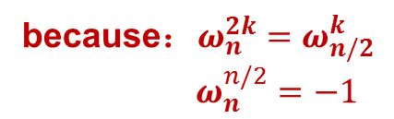
Fast Fourier Transform
because：$ω_{n}^{2k}=ω_{n/2}^{k}$
$ω_{n}^{n/2}=−1$
Discrete Fourier transform (DFT)
$y_{5}=a_{0}+a_{1}ω_{8}^{5}+a_{2}ω_{8}^{10}+a_{3}ω_{8}^{15}+a_{4}ω_{8}^{20}+a_{5}ω_{8}^{25}+a_{6}ω_{8}^{30}+a_{7}ω_{8}^{35}$
$=a_{0}+a_{2}ω_{8}^{10}+a_{4}ω_{8}^{20}+a_{6}ω_{8}^{30}+ω_{8}^{5}(a_{1}+a_{3}ω_{8}^{2}+a_{5}ω_{8}^{4}+a_{7}ω_{8}^{6})$
$=a_{0}+a_{2}ω_{4}^{1}+a_{4}ω_{4}^{2}+a_{6}ω_{4}^{3}−ω_{8}^{1}(a_{1}+a_{3}ω_{4}^{1}+a_{5}ω_{4}^{2}+a_{7}ω_{4}^{3})$
$=a_{0}+a_{4}ω_{4}^{2}+ω_{4}^{1}\left(a_{2}+a_{6}ω_{4}^{2}\right)−ω_{8}^{1}(a_{1}+a_{5}ω_{4}^{2}+ω_{4}^{1}(a_{3}+a_{7}ω_{4}^{2}))$
$=a_{0}+a_{4}ω_{2}^{1}+ω_{4}^{1}\left(a_{2}+a_{6}ω_{2}^{1}\right)−ω_{8}^{1}(a_{1}+a_{5}ω_{2}^{1}+ω_{4}^{1}(a_{3}+a_{7}ω_{2}^{1}))$

Slide 44
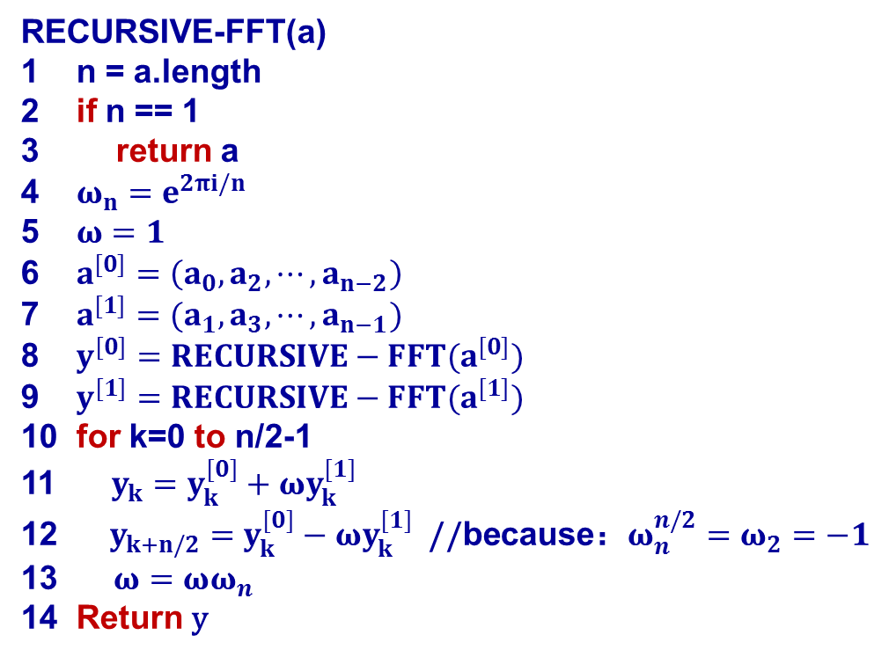
Fast Fourier Transform
RECURSIVE-FFT(a)
1 n = a.length
2 if n == 1
return a
4 $ω_{n}=e^{2πi/n}$
5 $ω=1$
6 $a^{[0]}=\left(a_{0},a_{2},⋯,a_{n−2}\right)$
7 $a^{[1]}=(a_{1},a_{3},⋯,a_{n−1})$
8 $y^{[0]}=RECURSIVE−FFT(a^{[0]})$
9 $y^{[1]}=RECURSIVE−FFT(a^{[1]})$
10 for k=0 to n/2-1
11 $y_{k}=y_{k}^{[0]}+ωy_{k}^{[1]}$
12 $y_{k+n/2}=y_{k}^{[0]}−ωy_{k}^{[1]}$ //because：$ω_{n}^{n/2}=ω_{2}=−1$
13 $ω=ωω_{n}$
14 Return y
T(n)=2T(n/2)+ O(n)
T(n)=O(n㏒n)
T(n/2)
T(n/2)
O(n)

Slide 45
Convex Hull
Given a n-point set Q on 2-D surface
Convex hull of Q is convex polygon P，
Points of Q is on P or inside P
凸多边形P是具有如下性质多边形：
连接P内任意两点的边都在P内

Slide 46
Convex Hull
Graham-scan algorithm
Most bottom and left point p₀, line p₀ to other points
Sort by the angles in increasing order
Use a stack to find the convex hull

Slide 47
Convex Hull
Graham-scan algorithm
p₇
p₉
p₃
p₈
p₆
p₅
p₄
p₁₀
p₂
p₁
p₀
Notes:
点乘,也叫向量的内积、数量积.顾名思义,求下来的结果是一个数.向量a·向量b=|a||b|cos
叉乘,也叫向量的外积、向量积.顾名思义,求下来的结果是一个向量,记这个向量为c.|向量c|=|向量a×向量b|=|a||b|sin，向量c的方向与a,b所在的平面垂直,且方向要用“右手法则”判断

Slide 48
Convex Hull
Graham-scan algorithm
p₇
p₉
p₃
p₈
p₆
p₅
p₄
p₁₀
p₂
p₁
p₀

Slide 49
Convex Hull
Graham-scan algorithm
p₇
p₉
p₃
p₈
p₆
p₅
p₄
p₁₀
p₂
p₁
p₀

Slide 50
Convex Hull
Graham-scan algorithm
p₇
p₉
p₃
p₈
p₆
p₅
p₄
p₁₀
p₂
p₁
p₀

Slide 51
Convex Hull
Graham-scan algorithm
p₇
p₉
p₃
p₈
p₆
p₅
p₄
p₁₀
p₂
p₁
p₀

Slide 52
Convex Hull
Graham-scan algorithm
p₇
p₉
p₃
p₈
p₆
p₅
p₄
p₁₀
p₂
p₁
p₀

Slide 53
Convex Hull
Graham-scan algorithm
p₇
p₉
p₃
p₈
p₆
p₅
p₄
p₁₀
p₂
p₁
p₀

Slide 54
Convex Hull
Graham-scan algorithm
循环为什么是O(n)
后面会介绍平摊分析
最多n次入栈，
那么出栈也是最多n次
Graham-scan(Q)
1. Most bottom and left point p₀；
2. Line p₀ to other points and sort in counterclockwise
let it be <p₁, p₂, …, p_{m}>；
3. Push(p₀, S); Push(p₁, S); Push(p₂, S);
4. FOR i=3 TO m DO
5. While Next2top(S)、Top(S) and p_{i} move clockwise Do
6. Pop(S);
7. Push(p_{i}, S);
8. Rerurn S；
O(n)
O(nlogn)
O(1)
O(n)
Time O(nlogn)

Slide 55
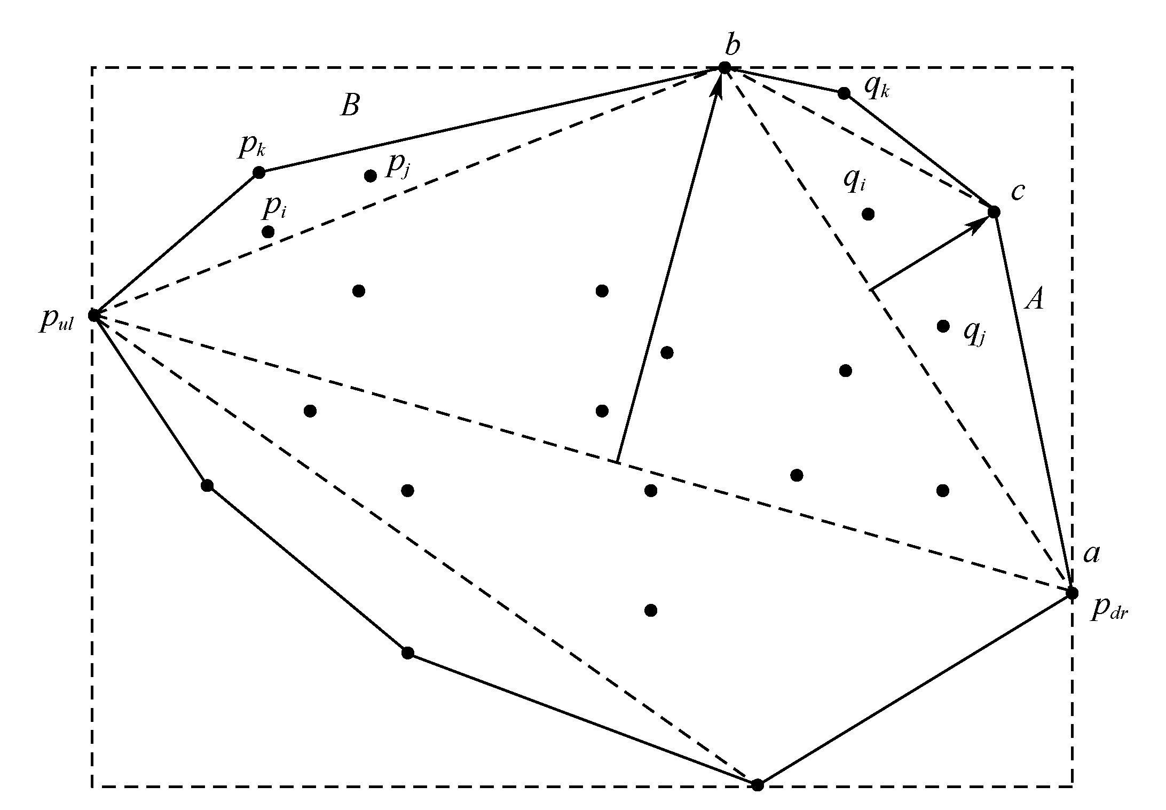
Convex Hull
Divide and conquer
Most bottom and right p_{dr}, most up and left p_{ul}
Line p_{dr} p_{ul} divide points into two parts
Recursively find the convex hull

Slide 56
Convex Hull
Divide and conquer
S₁be set of points on right side of p_{dr} p_{ul} (S₁may be empty)
Find in S₁the b farthest away from line p_{dr} p_{ul}
Line p_{dr}and b ，b and p_{ul}
A be points on right of p_{dr}b, B be points on right of bp_{ul}
Recursively process p_{dr}b and A、bp_{ul} and B

Slide 57
Convex Hull
Divide and conquer
Average time O(nlogn)
Worst time O(n²)

Slide 58
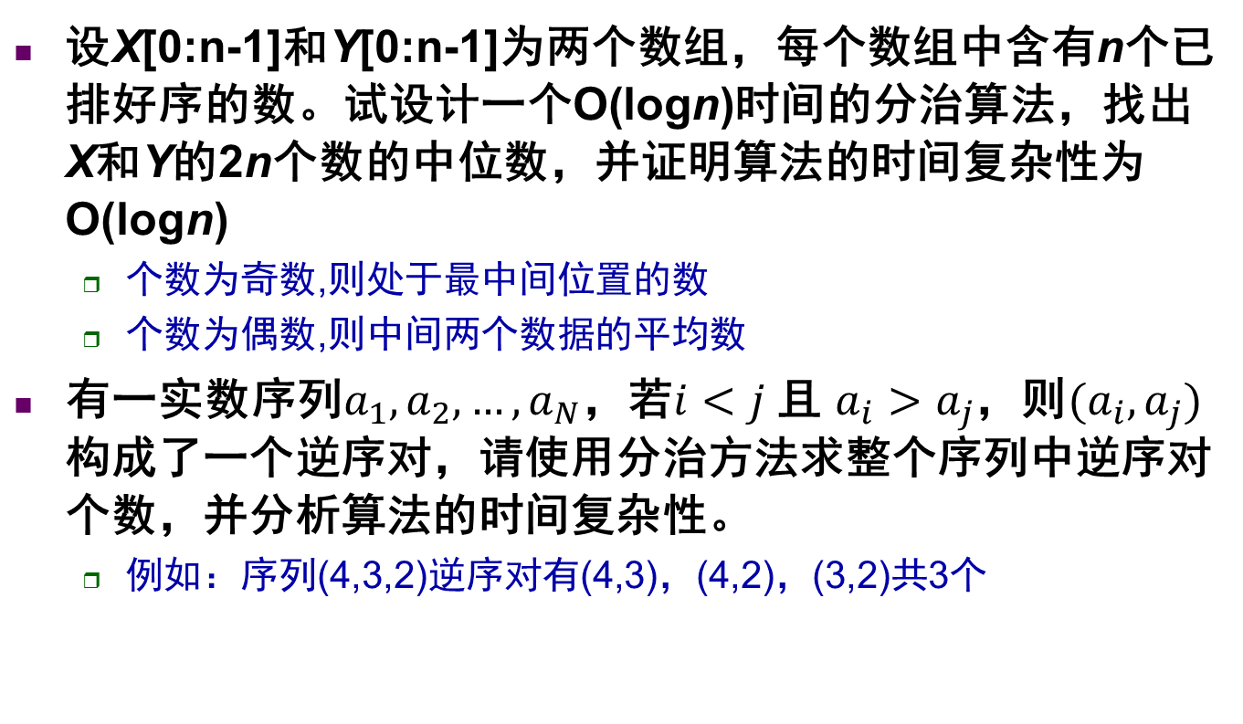
设X[0:n-1]和Y[0:n-1]为两个数组，每个数组中含有n个已排好序的数。试设计一个O(logn)时间的分治算法，找出X和Y的2n个数的中位数，并证明算法的时间复杂性为O(logn)
个数为奇数,则处于最中间位置的数
个数为偶数,则中间两个数据的平均数
有一实数序列$a_{1},a_{2},…,a_{N}$，若$i<j$ 且 $a_{i}>a_{j}$，则$(a_{i},a_{j})$构成了一个逆序对，请使用分治方法求整个序列中逆序对个数，并分析算法的时间复杂性。
例如：序列(4,3,2)逆序对有(4,3)，(4,2)，(3,2)共3个

